Slide 1
Diversity
Diversity, and its importance for a thriving society

Slide 2
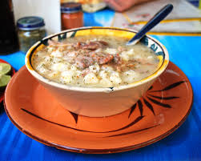
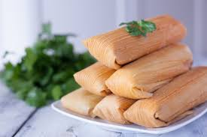
Countries like Mexico that contributes to diversity
The country provides numerous of foods such as
Pozole a soup that has corn, meat usually pork, and a whole ton of seasoning ( oregano, lime, hot sausce, and onions). The dish is made usually for celebrations
Tamale, a food made with corn (masa) and covered in corn husk or banana leaf. Tamale can also be filled with meats cheese and more. Delicious it may be, cooking this dish is quite time consuming.

Slide 3
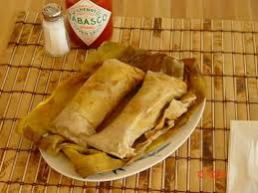
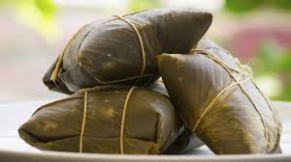
The diversification of food
Thanks to the efforts of migrating humans, many ideas were spread. Such ideas were about food.
As a result, there are many different verisons of pozole, and tamales
For tamales, in some parts like Mexico, tamales are ,made with nixtamalized corn. However in Central America, tamales are made with yellow corn, chipilin (a green leaf), and white corn

Slide 4
The importance of Diversity
Diversity is very important to a society if it wants to develop.
With diversity ideas are able to spread around. As a result these ideas are improved upon
Just like food, the dishes from Mexico were introduced to many places, and were later improved upon, with new ingrediants.

Slide 5
Conclusion
Diversity plays an important role to society where ideas spread and are improved upon.
An examples are Mexican dishes pozole and tamales, where it was introduced to many places, and now different recipes exist to make the dish in different ways
With diversity even food is able to become better as people try new ways to cook it
Highly recommend trying out these dishes especially Pozole, because you just can’t get enough of it.

